Slide 1


Python and Java: A Comparative Overview
This presentation explores the key differences between Python and Java, two popular programming languages widely used across various industries.
by Nsisong Akpaikpe

Slide 2
Introduction to Python and Java
Python
Java
Python is a high-level, interpreted language known for its readability and ease of use. It emphasizes code simplicity and is widely adopted for data science, machine learning, and web development.
Java is a compiled, object-oriented language renowned for its portability and platform independence. It's extensively used in enterprise applications, Android development, and back-end systems.

Slide 3
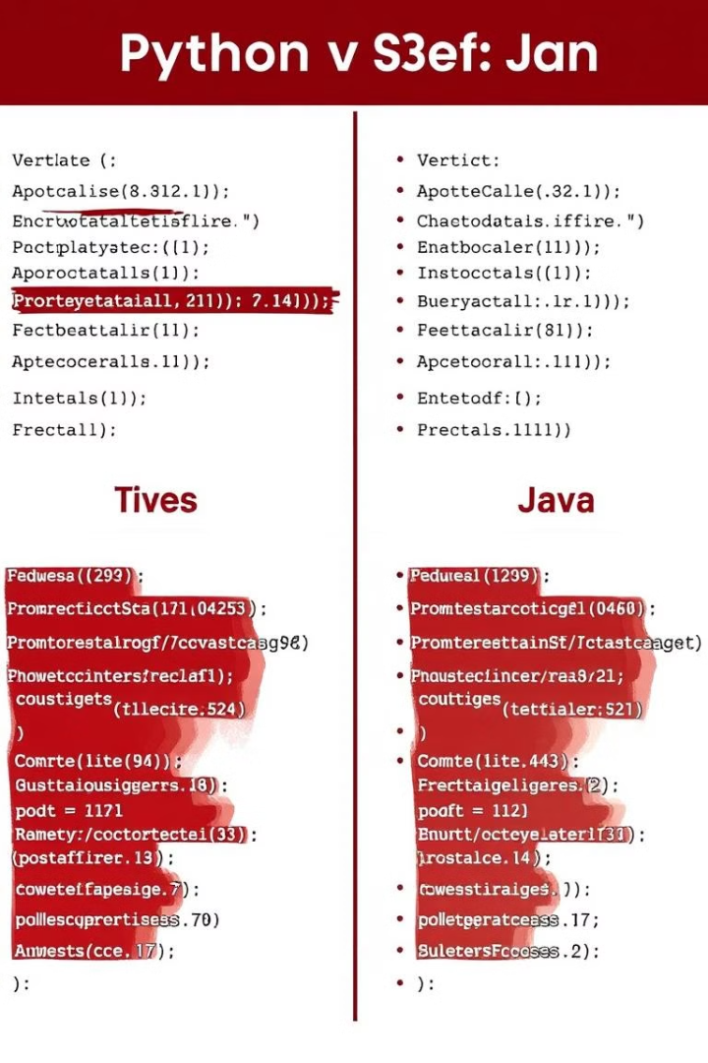
Syntax and Language Structure
1
Python
2
Java
Python's syntax is concise and intuitive, relying on indentation for code structure. It prioritizes readability and encourages cleaner, more concise code.
Java's syntax is more verbose and structured, with a focus on clarity and explicitness. It employs curly braces to define code blocks and utilizes a more formal syntax structure.

Slide 4
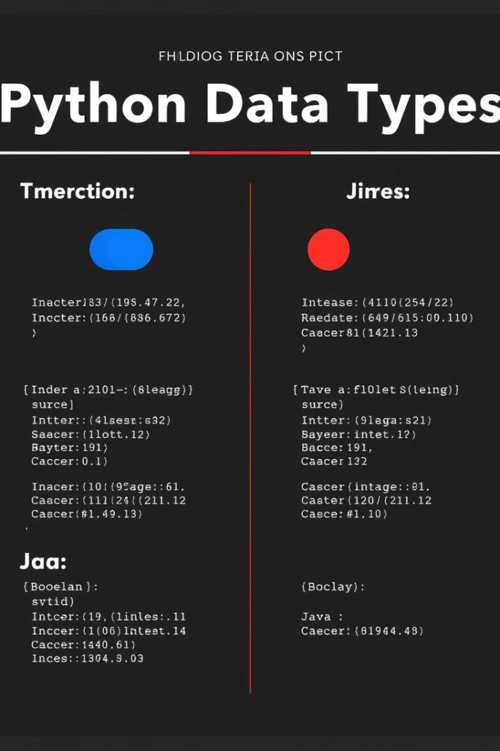
Data Types and Variable Handling
Feature
Python
Java
Data Types
Dynamic Typing
Static Typing
Variable Declaration
Implicit
Explicit

Slide 5
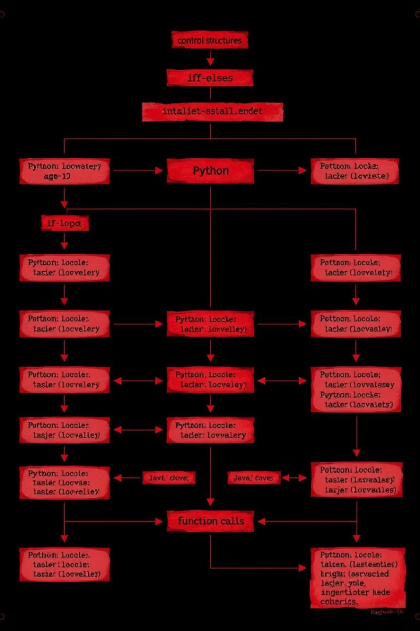



Control Structures and Functions
Conditional Statements
Both languages support common control structures, such as if-else statements, for decision-making.
Loops
For and while loops provide iterative capabilities for repeating code blocks.
Functions
Functions allow code modularity and reusability, promoting efficient programming practices.

Slide 6
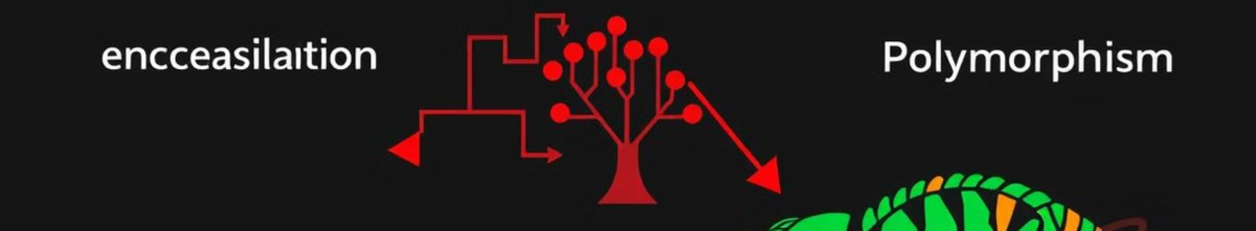
Object-Oriented Programming (OOP) Concepts
Encapsulation
Inheritance
Polymorphism
Data hiding and access control through classes and methods.
Creating new classes based on existing ones, promoting code reuse and extensibility.
Ability of objects to take on different forms, enabling flexibility and dynamic behavior.

Slide 7
Execution and Runtime Environment
Python
Java
Python is interpreted, meaning code is executed line by line without prior compilation. This allows for rapid prototyping and interactive development.
Java is compiled, requiring source code to be translated into machine-readable bytecode before execution. This enables platform independence and optimized performance.

Slide 8





Use Cases and Applications
Web Development
Data Science & Machine Learning
Mobile App Development
Enterprise Applications
Both languages excel in web development, with Python often used for back-end frameworks like Django and Flask, while Java powers enterprise-level web applications.
Python's rich libraries, such as NumPy, Pandas, and Scikit-learn, make it a popular choice for data analysis and machine learning tasks.
Java is the primary language for Android app development, while Python can be used with frameworks like Kivy for cross-platform mobile app development.
Java's robust features and scalability make it suitable for building complex enterprise systems, while Python is increasingly used for automation and data-driven decision-making.

Slide 9

Conclusion and Key Takeaways
1
Python
2
Java
3
Choose Wisely
Python is a versatile language known for its readability and ease of use, making it ideal for data science, machine learning, and rapid prototyping.
Java is a robust and scalable language well-suited for enterprise applications, Android development, and back-end systems.
The choice between Python and Java ultimately depends on the specific project requirements, developer preferences, and desired performance characteristics.

